Slide 1



University of Almeria
- Spain -.
HdM – International Week
Fernando Bienvenido (fbienven@ual.es)
Dept. of Computer Science – University of Almeria

Slide 2
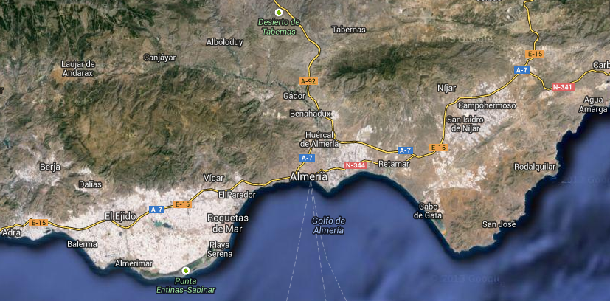
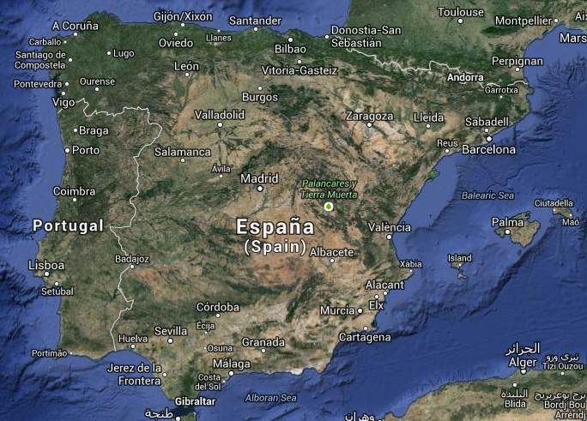
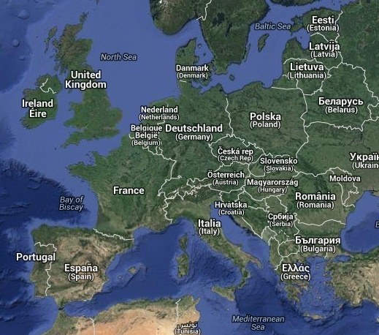
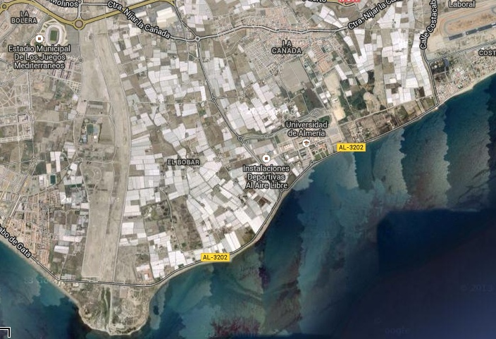
University of Almeria (Spain)

Slide 3
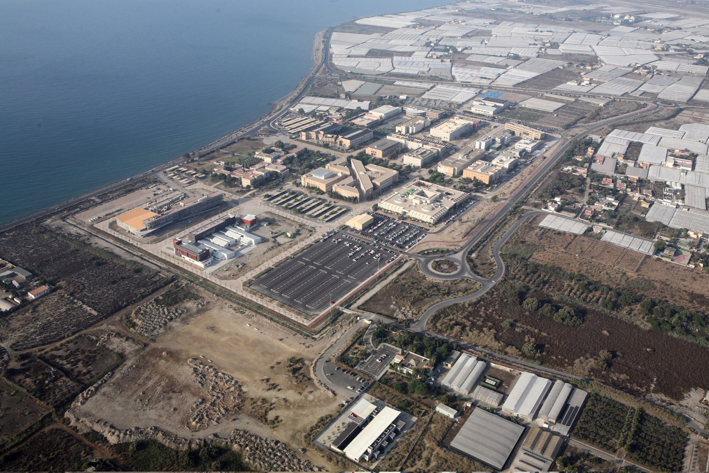

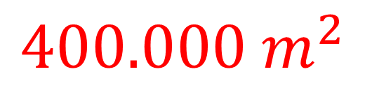
$${400.000 m}^{2}$$

Slide 4
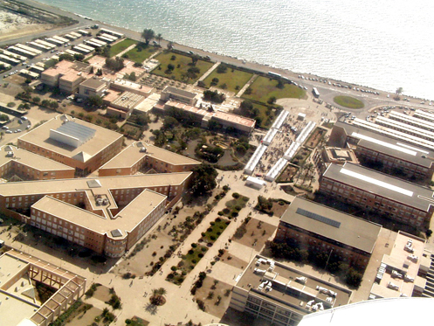


Summary
Public University - Only University in the Province of Almeria
Created in 1993 (segregated from the University of Granada)
Students = 14026 ( +600 doctorates)
Academic and Research Staff: 800 - Admistrative Staff: 500
Research Groups: 138 - Linked agriculture: 54
Oriented --- linked to its social environment
CeiA3 - Agrifood Campus of International Excellence *
CeiMar – Campus of International Excellence of the Sea *

Slide 5


Summary
8+1 Faculties, Colleges and Schools
    - College of Humanities
    - College of Law
    - College of Psychology
    - Economics and Business Studies College
    - Education Science College
    - Experimental Sciences College
    - Engineering School
    - Faculty of Health Sciences
    - Social Work School*

Slide 6
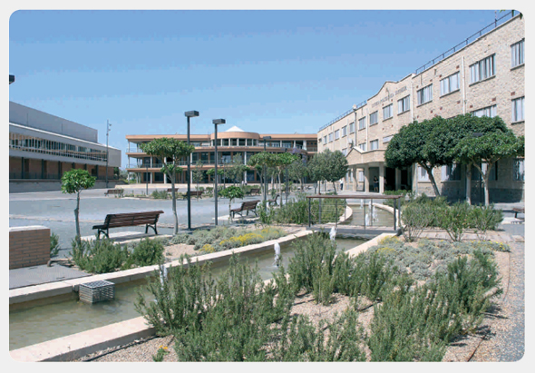
Minors?
We do not have minors at the University of Almeria (Spain)
For European Exchange (Erasmus):
  + We sign agreements for specific specialties:
    >Bachelor
  >Bachelor + Master Studies
Depending on the areas the student can select between a long list of subjects (both in English or Spanish), including some “general subjects”.

Slide 7
33 Bachelor Degrees, including:
Engineering and Architecture
- Degree in Agricultural Engineering (Curriculum 2015)
- Degree in Computer Engineering (Curriculum 2015)
- Degree in Electrical Engineering (Curriculum 2014)
- Degree in Industrial Chemical Engineering (Curriculum 2010)
- Degree in Industrial Electronic Engineering (Curriculum 2010)
- Degree in Mechanical Engineering (Curriculum 2010)

Slide 8
Bachelor Degrees
Science
- Degree in Biotechnology (Curriculum 2015)
- Degree in Chemistry (Curriculum 2009)
- Degree in Environment Studies (Curriculum 2009)
- Degree in Mathematics (Curriculum 2010)
Health Science
- Degree in Nursing Science (Curriculum 2009)
- Degree in Physiotherapy (Curriculum 2009)
Degree in Psychology (Curriculum 2010)
Degree in Medicine (Curriculum 2022)

Slide 9
Some English Courses – Bachelor Degrees
School of Engineering - Course 21-22

Slide 10
Some English Courses – Bachelor Degrees
School of Economics and Business - Course 21-22

Slide 11
Pseudo – Minors -- Some options
Option 1 Spring Semester (Feb-Jun) – Total : 30 ETCS – Fully in English --
63104226 – Enterprise Creation. Degree in Economy. Credits: 6 Semester: Spring
67102208 - Consumer Analysis. Degree in Marketing. Credits: 6 Semester: Spring
62102208 - Organization design. Degree in Business. Credits: 6 Semester: Spring
62104207 – Strategic Management II. Degree in Business. Credits: 6 Semester: Spring
67102223 - Company Organization. Degree in Marketing. Credits: 6 Semester: Spring
Recommendations: 1. Change one subject for Spanish Lessons / Certificate.
2. If possible select other courses in Spanish (ask).

Slide 12
Pseudo – Minors -- Some options
Option 2 Spring Semester (Feb-Jun) – Total : 30 ETCS – Fully in English --
40154308 - Software Engineering Processes 2.. Degree in Computer Engineering . Credits: 6 Semester: Spring
40153320 - Peripherals and Interfaces. Degree in Computer Engineering. Credits: 6 Semester: Spring
40152203 - Data Structures and Algorithms II. Degree in Computer Engineering. Credits: 6. Semester: Spring
62102208 - Organization design. Degree in Business. Credits: 6 Semester: Spring
63104226 – Enterprise Creation. Degree in Economy. Credits: 6 Semester: Spring
Recommendations: 1. Change one subject for Spanish Lessons / Certificate.
2. If possible select some other course in Spanish (ask).

Slide 13
Pseudo – Minors -- Some options
There are much more options with the Master courses in English.
Some Masters are fully in English (much more subjects).
Spanish is the second mother-language spoken language in the world, and third including second language (and similar to Portuguese, second language in USA and Brazil).
Get some credits from the Language School and improve your language skills and background.
Recommendations: 1. Change one subject for Spanish Lessons / Certificate.
2. If possible select some other course in Spanish (ask).

Slide 14
Masters
40 Official Master Degrees + 11 Own Master Degrees
5 ThematicAreas:
  Art & Humanities
  Sciences ***
  Law and Social Sciences *
  Health Sciences
  Engineering and Architecture ***

Slide 15
Masters
Arts and Humanities
Master in English Studies: Professional Applications and Intercultural Comm
Master in Social Communication
University Master in Historical Analysis of the Present
Science
Master en Uso Sostenible de Recursos Naturales y Servicios Ecosistémicos
Master in Chemistry
Master in Genetics and Evolution
Master in Industrial and Agroalimentary Biotechnology
Master in Matemathics + Secondary Education Teaching
Master in Mathematics

Slide 16
40 Masters,
Technology/Business
Engineering and Architecture
Master in Agronomic Engineering
Master in Chemical Engineering
Master in Industrial Chemical Engineering
Master in Mediterranean Greenhouse Horticulture
Master in Representation and Design in Engineering and Architecture
Master in Solar Energy (new)
Master in Technologies and Application of Information Engineering (new)
Social and Legal Science
Master in International Business Administration and Languages
Master en Account Auditory (new)
Master in Business Law and Agrifood
Master in Development and Sustainable Local Codevelopment
Master in Environment Education
Master in Management and Business Economics
Master in Occupational Risk Prevention
…..

Slide 17
Languagess
Languages:
* Spanish most of the Bachelor Degrees and Masters.
* Some subjects are bilingual (Spanish – English)
* Some masters 80% English.
http://cms.ual.es/idc/groups/public/@vic/@vinternacional/documents/documento/degreemaster1718.pdf
Recommended Linguistic preparation:
* Spanish Intensive Course at the UAL Language Center
(2-6 months), for common live and fun.
* Sharing apartment with local and international students.

Slide 18
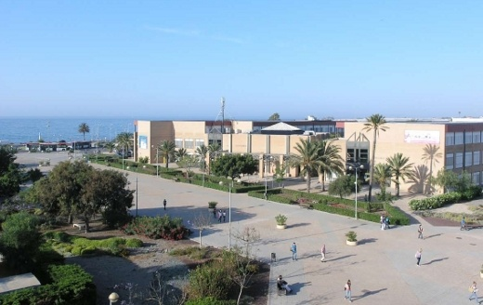
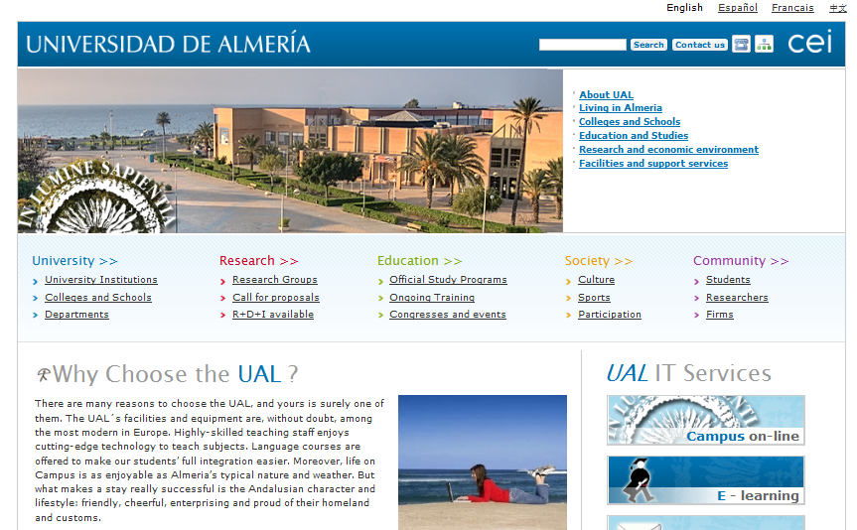
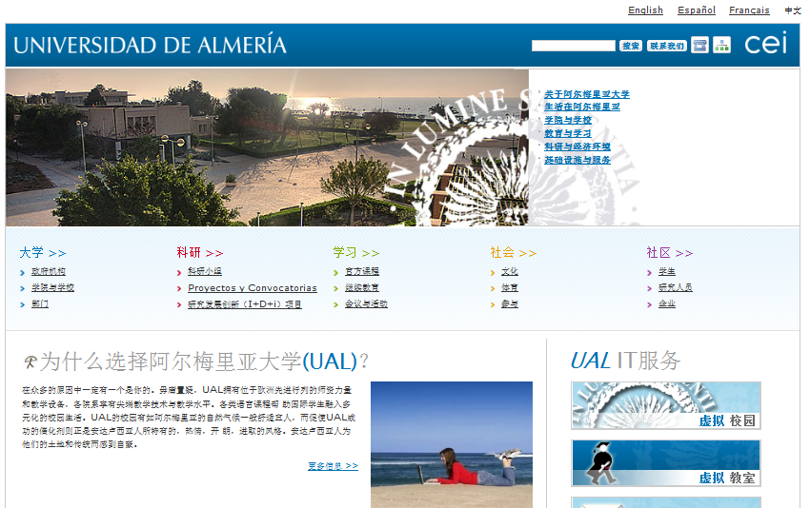
More Information
Web: http://cms.ual.es/UAL/en/index.htm

Slide 19
Living Almeria
University
Downtown

Slide 20
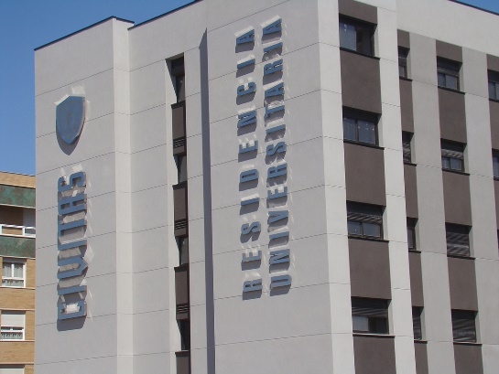
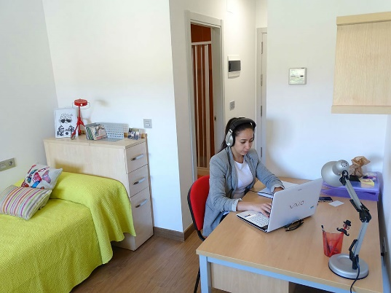
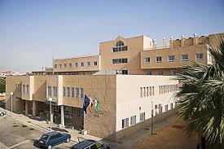
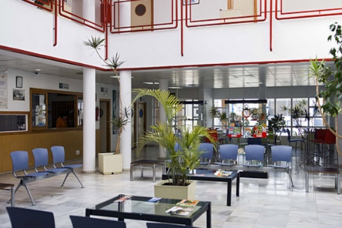
Living Almeria
Downtown
University

Slide 21
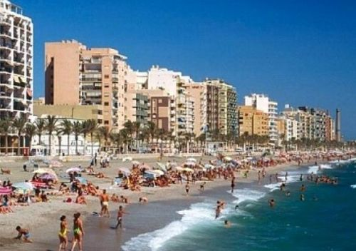
Living Almeria
Renting apartments / rooms
University
Downtown

Slide 22
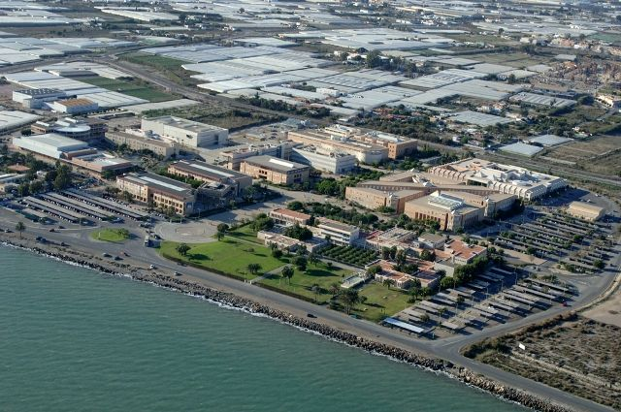

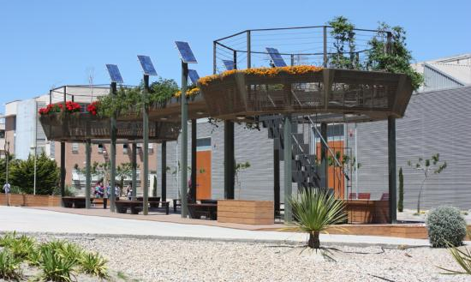
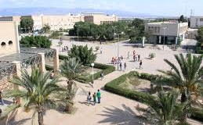
University of Almeria (Spain) - Images
Presentation

Slide 23
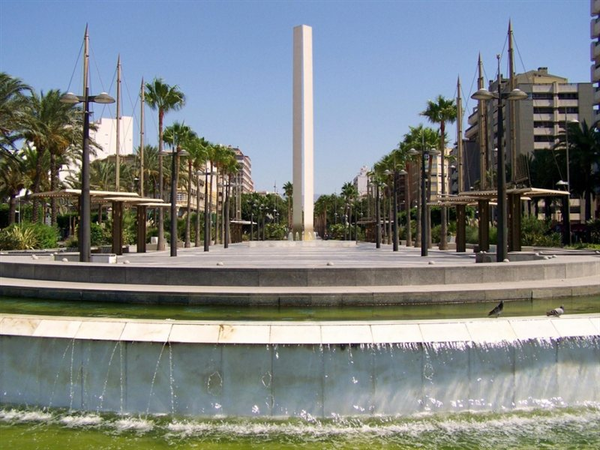


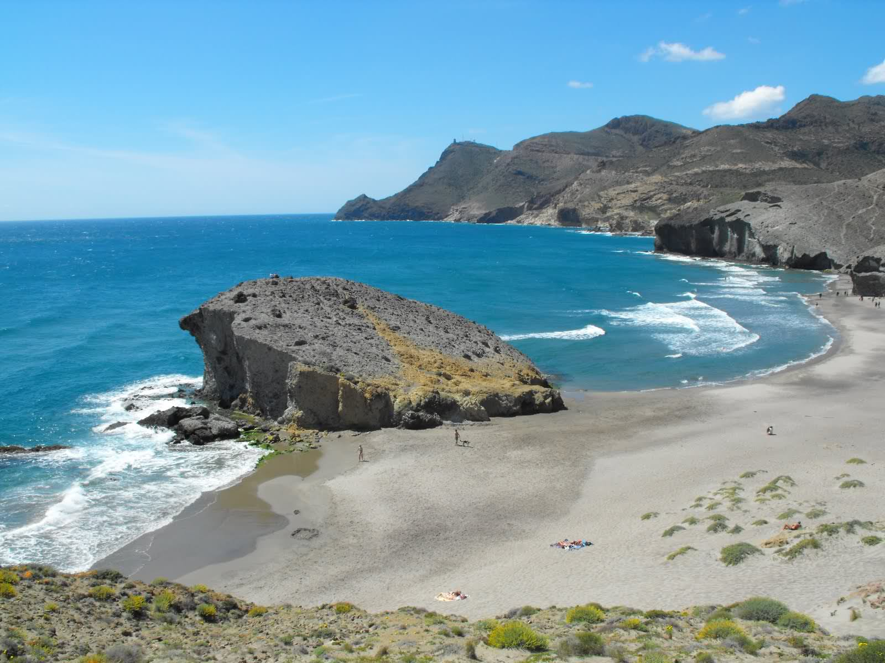
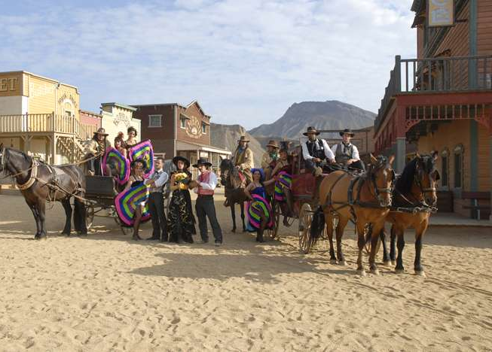
Living Almeria
Thank You
We wait for you in Almeria

